Slide 1
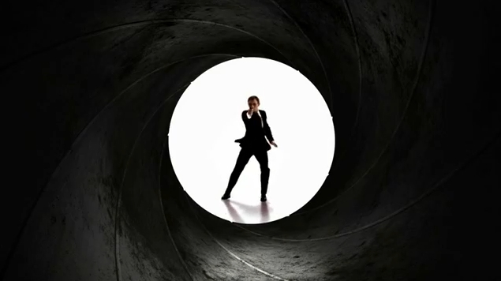
James Bond-Lesson 1

Slide 2
L.O: To know where the character James bond came from and what the stories are based around.
To be able to perform the teacher lead sequence.
All (3b,3a,4c): I need to be more in time with the music.
There are some strength in my movements.
I can perform simple facial expressions.
Most(4b): I can perform in time with the music show correct dynamics.
I can show control in my actions when I perform.
I can show a James Bond character in my performance.
Some(4a,5c,5b) :
I can perform in time with the music.
I can use dynamics to add to the meaning of the dance and the mood of the music.
I can use appropriate facial expression for the music.

Slide 3
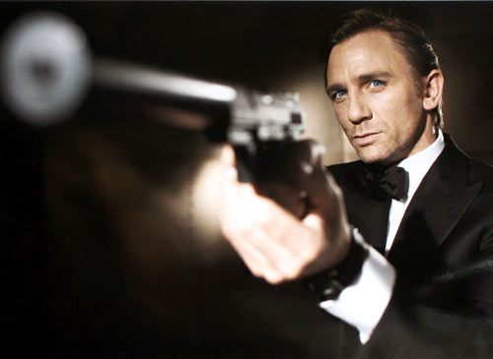
Who is James Bond?
James Bond, code name 007, is a fictional character created in 1953 by writer Ian Fleming, who featured him in twelve novels.
James Bond is a secret agent for the British MI6 service with a licence to kill. Stories normally start with James sent on a mission to stop a bad guy. Finds a girl and saves the British empire.
James bond is famous for his Guns,
vehicles and gadgets.
The current James Bond actor is Daniel
Craig who recently filmed Sky fall.
This year is the 50th anniversary of
the first James Bond.
http://www.youtube.com/watch?v=-qvWD9MPSkY

Slide 4
Teacher led section
2 sets of 8
-Clasp hands as if holding a gun against the left shoulder. Look down
-Look up when the words: Bond, James Bond.
-8 counts to move arms holding gun gesture down, round and back up to right shoulder.
-4 counts to walk forwards R/L/R/ legs apart on 4th count.
5 jump to the right,
6 jump to the left.
7 cross right foot over it.
8 turn to face back bring arms down.
Third set of 8
1 cross arms over with fist in front of face.
2 open arms out as if holding onto parachute strings
3,4, pause (arms still up)
5 look right
6 look left
7 step to the right
8 step together.

Slide 5
Peer assessment
Pupils will watch partner perform the dance to the music and perfect it.
Pupils will assess partners routine in relation to the L.O.

Slide 6
L.O: To know where the character James bond came from and what the stories are based around.
To be able to perform the teacher lead sequence.
All (3b,3a,4c): I need to be more in time with the music.
There are some strength in my movements.
I can perform simple facial expressions.
Most(4b): I can perform in time with the music show correct dynamics.
I can show control in my actions when I perform.
I can show a James Bond character in my performance.
Some(4a,5c,5b) :
I can perform in time with the music.
I can use dynamics to add to the meaning of the dance and the mood of the music.
I can use appropriate facial expression for the music.

