Slide 1
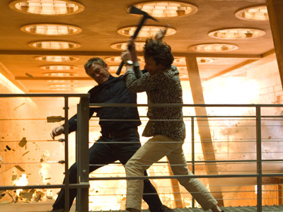
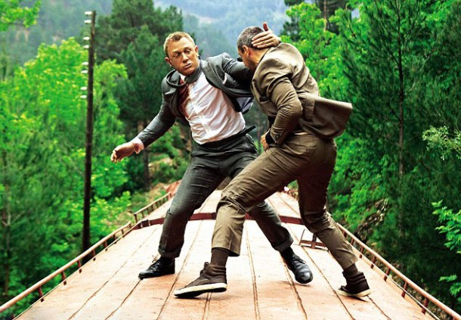
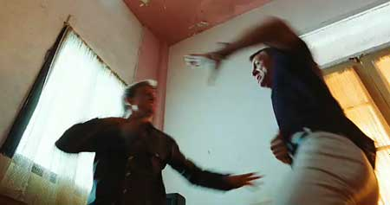
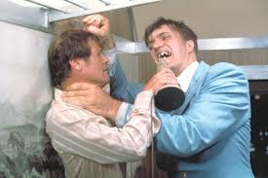
James Bond – None contact fighting scene – Lesson 4

Slide 2
L.O: pupils will be able to create a basic combat scene with NO contact.
All (3b,3a,4c): to get the basic ginga movement most of the time.
Most(4b): to get the advance ginga movement all of the time and add in slight attacking and defending movements.
Some(4a,5c,5b): to be able to do an advance ginga movement with hand and body position and add complex movements in your scene.

Slide 3
Basic steps
http://www.youtube.com/watch?v=WV-Sf5-aCcc
Attacks and defence
http://www.youtube.com/watch?v=9K0Td7jIYlw&feature=fvwrel

Slide 4
Capoeira – Movements
Attacking | Defending
Kicking | Getting out of the way
Punching | Blocking

Slide 5
Stepping on a box

Slide 6
L.O: pupils will be able to create a basic combat scene with NO contact.
All (3b,3a,4c): to get the basic ginga movement most of the time.
Most(4b): to get the advance ginga movement all of the time and add in slight attacking and defending movements.
Some(4a,5c,5b): to be able to do an advance ginga movement with hand and body position and add complex movements in your scene.

